Slide 1
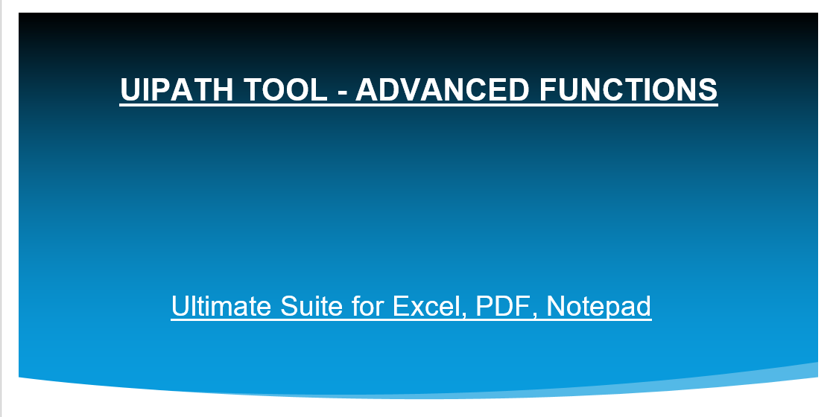

Slide 2
Objective
This document should be useful to anyone who wishes to use Filter Range & Pivot Table, Text to columns, Find & Replace, Copy Paste, etc.
This document provides step by step instructions on how to use this functions to perform various operations with below listed functions using UiPath Tool without requirement to code it from the scratch.
Applications Involved
The functions explained in this document involve the following applications:
UiPath
Microsoft Excel
Notepad
Note : -
In most of the functions you will be able to see the watermark for each fields. By looking at that you will come to know that what exactly you have to mention in that field.
In most of the functions you need not to add a activity to create a worksheet, functions itself checks the sheet, if the sheet is not exist then it creates an worksheet.
There are two different functions with similar look : -
Pivot Table which works with Excel Application scope – Input / Output can be Datatable & Sheet.
Pivot Table which works without Excel Application scope – Input / Output is only Datatable.
Filter Range Data which works with Excel Application scope – Input / Output can be Datatable & Sheet.
Filter Range Data which works without Excel Application scope – Input / Output is only Datatable.

Slide 3
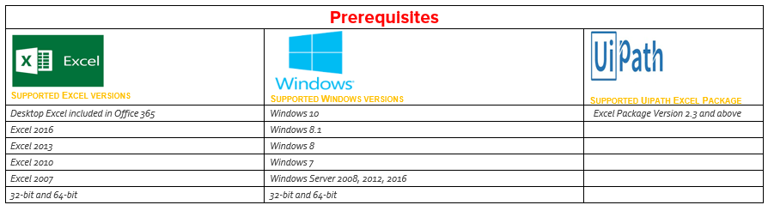

Slide 4
Comprehensive set of time-saving/ease of coding tools
With this collection of professional tools, you can accomplish any task impeccably without errors or delays. Highly experienced with Office development embodied in the perfect code of solutions that work flawlessly on all Excel versions, Datatable, PDF, Notepad, etc.
The Ultimate Suite was designed to address the needs of all users that work with Excel, PDF, Notepad on a daily basis. So, why don't we add a few more tools to make your life a little easier and your work a bit more comfortable? Just think of them as a nice add on tools to help you manage your coding's with accuracy and perfection.
The Excel activities package aids users to automate all aspects of Microsoft Excel, as we know it is an application intensely used by many in all types of businesses. It contains activities that enable you to Create a Pivot Table, Filter range data, Find & Replace, Text to columns and much more. You can also remove duplicates, copy paste the data, etc. All the activities in the latter category have to be included in Excel Application Scope to work.
Notepad is a pretty popular tool among enterprise users, to say the least. As a result, automating this part of the office life is a must. Package contains multiple activities that enable you to manipulate with .txt / .prn files. Use the functions to extract the certain contents from notepad file, export them to excel.

Slide 5
PIVOT TABLE GRID INTEGRATION – With or without Excel Application Scope
A PivotTable is an interactive way to quickly summarize large amounts of data.
You can use a PivotTable to analyze numerical data in detail, and answer unanticipated questions about your data. A PivotTable is especially designed for:
Querying large amounts of data in many user-friendly ways.
Subtotaling and aggregating numeric data, summarizing data by categories and subcategories, and creating custom calculations and formulas.
Expanding and collapsing levels of data to focus your results, and drilling down to details from the summary data for areas of interest to you.

Slide 6
PIVOT TABLE GRID INTEGRATION – With or without Excel Application Scope
Moving rows to columns or columns to rows (or "pivoting") to see different summaries of the source data.
Filtering, sorting, grouping, and conditionally formatting the most useful and interesting subset of data enabling you to focus on just the information you want.
Presenting concise, attractive, and annotated online or printed reports.

Slide 7
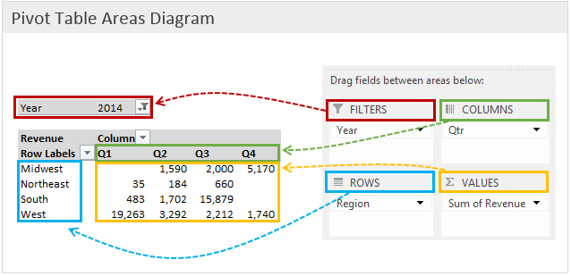
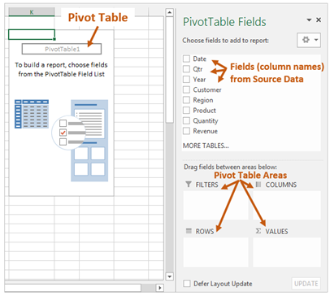
The following diagram shows where each area of the pivot table is located on the report. This can be used as a guide to familiarize yourself with the different areas.

Slide 8
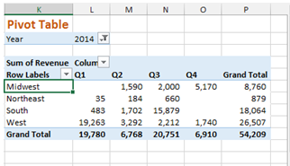
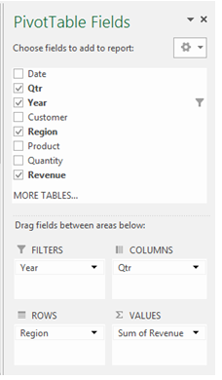
The Pivot Table Areas The pivot table contains four areas that you can drag the fields into to create a report. Filters area, Columns area, Rows area, Values area

Slide 9
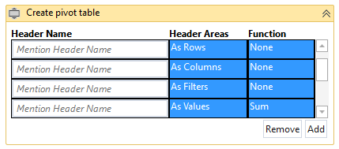
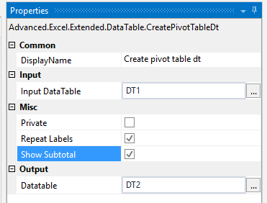
Datatable : - Provide the Datatable name
Output Datatable : - Output as Datatable
Checkbox: Repeat Labels
Checkbox: Show Subtotals
Note : By default pivot table will get generated in Tabular layout. In case if you want to change the layout to
compact or any then use the Pivot Table Layout changer function.
-------------------------------TO DO IN PIVOT TABLE GRID---------------------------
Header Name : - Provide the Header Name (Ex. “US Employees”) or row(2).ToString
Header Areas : Dropdown list (As rows, columns, filters, values)
Function : Dropdown list (Sum, Count, Minimum, Maximum, Average)
Note : - For Header Areas apart from “Values” - Please select “None” in Function Column

Slide 10
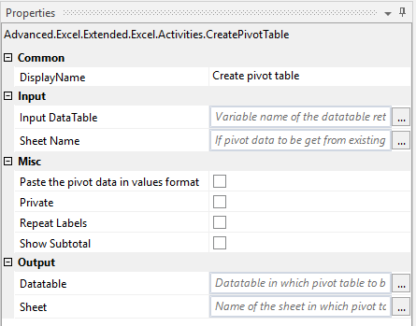
Note : - (Input can be either Datatable / Existing Sheet)
Sheet : - Provide the Sheet name
Datatable : - Provide the Datatable name
Output Datatable : - Output as Datatable
Output Sheet : - Output as Sheet
Additional Features : - Checkbox: If you want the pivot data needs to be pasted as Values
Checkbox: Repeat Labels & Show Subtotals
Note : By default pivot table will get generated in Tabular layout. In case if you want to change the layout to
compact or any then use the Pivot Table Layout changer function.
-------------------------------TO DO IN PIVOT TABLE GRID---------------------------
Header Name : - Provide the Header Name (Ex. “US Employees”) or Row(2).ToString
Header Areas : Dropdown list (As rows, columns, filters, values)
Function : Dropdown list (Sum, Count, Minimum, Maximum, Average)
Note : - For Header Areas apart from “Values” - Please select “None” in Function Column.

Slide 11
FILTER RANGE GRID INTEGRATION – With or without Excel Application Scope
AutoFilter is an easy way to turn the values in Excel column into specific filters based on the cell contents.
You can filter based on choices you make from a list, or you can create specific filters to focus on exactly the data that you want to see.
By filtering information in a worksheet, you can find values quickly.
You can filter on one or more columns of data. With filtering, you can control not only what you want to see, but what you want to exclude.

Slide 12
FILTER RANGE GRID INTEGRATION – With or without Excel Application Scope
Excel is versatile in the filter settings. You’re not limited to just items containing a specific value.
Equals
Does not equal
Is greater than
Is greater than or equal to
Is less than
Is less than or equal to
Begins with
Does not begins with
Ends with
Does not ends with
Contains
Does not contains

Slide 13
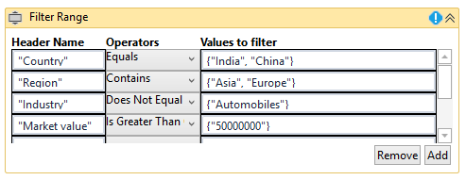
The following diagram shows where each operators of the filter data is located. This can be used as a guide to familiarize yourself with the different operators.

Slide 14
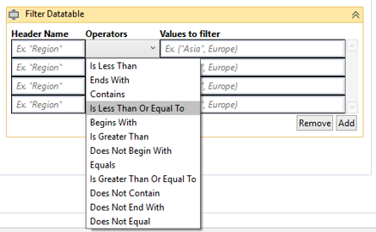
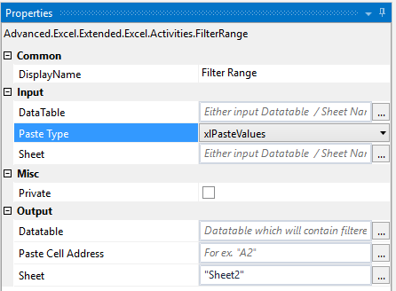
----------------------------------------TO DO IN FILTER GRID-----------------------------------------------------
Header Name : - Provide the Header Name (Ex. “US Employees”) and you can pass the header name also as Variable.
Operators : - Dropdown list (Equal, contains, begins with, etc.)
Values to filter : - Pass the values / variables which you want to be filtered (Array)
Note : - (Input can be either Datatable / Existing Sheet)
Sheet Name : - Sheet name
Input Datatable Datatable Output Datatable : - Datatable Output Sheet : - Sheet Name **Paste Range : - Range as (“A1”) *Paste Type Formats : - Dropdown (xlPasteAll, xlPasteValues, etc.)
Note : Highlighted with **symbol is valid only if you want the output in sheet.

Slide 15
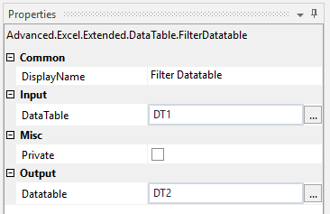
----------------------------------------TO DO IN FILTER GRID-----------------------------------------------------
Header Name : - Provide the Header Name (Ex. “US Employees”) and you can pass the header name also as Variable.
Operators : - Dropdown list (Equal, contains, begins with, etc.)
Values to filter : - Pass the values / variables which you want to be filtered (Array)
Datatable name Input Datatable Name
Output Datatable : - Output Datatable

Slide 16
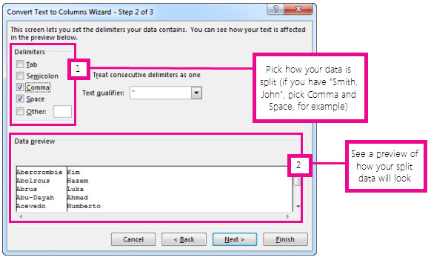
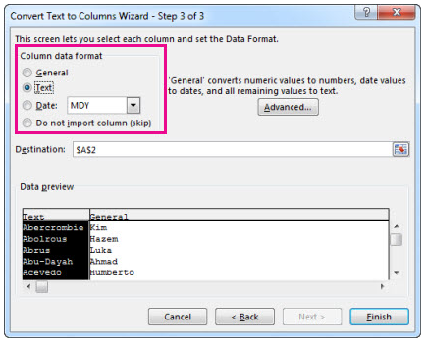
TEXT TO COLUMNS – DELIMITER
Split text into different columns with the Convert Text to Columns Wizard.
You can take the text in one or more cells, and spread it out across multiple cells. This is called parsing, and is the opposite of concatenating, where you can combine text from two or more cells into one cell.

Slide 17
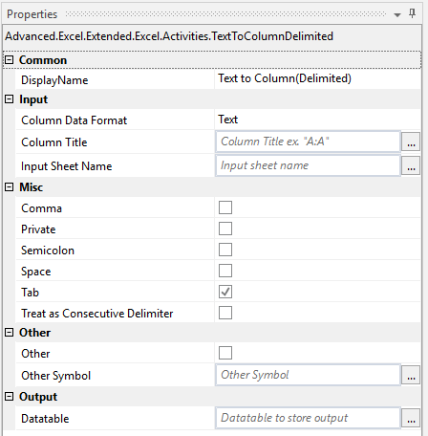
Note: Select as many rows as you want, but no more than one column. Make sure there’s enough empty columns to the right so nothing over there gets overwritten. If you don’t have enough empty columns, add them. Sheet Name : - Provide the Sheet name Column Title : - (“A:A” or “E:E”) Column Format : - Dropdown (General / Text) [Note : By default all columns will be in Text / General) Datatable: - Optional - Provide the Datatable name to get the output in DT Additional Features : - Checkbox: If you want to split based on Comma symbol Checkbox: If you want to split based on Space symbol Checkbox: If you want to split based on Semicolon symbol Other : - Checkbox: If you want to split based on Other (user specific) symbol. Enable checkbox and provide the values in Symbol field (Ex. @, $, %, #) Treat as Consecutive Delimiter : Checkbox : Enable it if you want to consider consecutive symbol as single symbol.

Slide 18
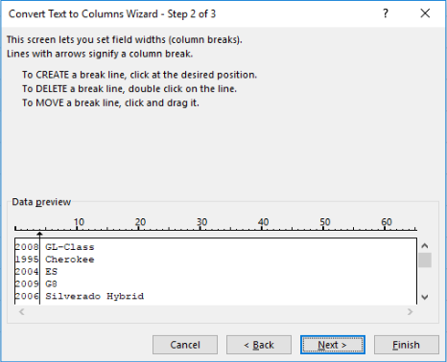
TEXT TO COLUMNS – FIXED WIDTH
Split text into different columns with the Convert Text to Columns Wizard.
You can take the text in one or more cells, and spread it out across multiple cells. This is called parsing, and is the opposite of concatenating, where you can combine text from two or more cells into one cell.

Slide 19
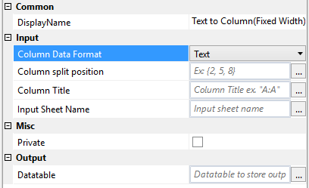
Note: Select as many rows as you want, but no more than one column. Make sure there’s enough empty columns to the right so nothing over there gets overwritten. If you don’t have enough empty columns, add them.
Sheet Name : - Provide the Sheet name
Column Title : - (“A:A” or “E:E”)
Column Format : - Dropdown (General / Text)
[Note : By default all columns will be in Text / General
Column Split Position : - For ex. {4,9,14,18,29,35,47,53,57,65,70}
Output Datatable: - Optional - Provide the Datatable name to get the output in DT

Slide 20
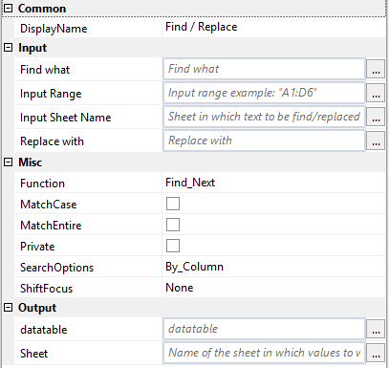
FIND & REPLACE – ADVANCED TECHNOLOGY
Excel Find and Replace feature can be a powerful tool.
Use Find and Replace to search for — and optionally replace — text or values in a worksheet.
You can narrow the search results by specifying formatting to look for as well as search options, including Match Case.

Slide 21
Purpose : - 1. It will Find the given word and replace with given word(Find what: “India” & Replace with :“China”
2. It will Find the given word and return the cell address and corresponding value of that cell.
______________________________________________________________________________________________________________________
Input : - Provide the Sheet name
Range : - Ex. “A1:A500”
Find what : - “India”
Replace with (Optional) : - “China”
Output : - Datatable (Not applicable in case of Replace) Output : - Sheet (Not applicable in case of Replace)
Search Options : - Dropdown (By Row , By Column)
Function : - Dropdown (Find Next, Find All, Replace Single, Replace All )
Shift Focus : - Dropdown (None, One, Two, Three and so on.)
Purpose of Shift Focus : - If you are searching for word as (“--------------------------------“ – Find what criteria) but you want to pull the values which is one cell below of that "find what criteria" then you can mention shift focus as “One” / “Two” etc.
Select Find Next to find further instances or Find All to see every instance of the search term.
Select Replace will replace individual instances, while Replace All will replace every instance of the text throughout the sheet
Match Case: Check this box if you want your search to be case-specific.
Match Entire Cell Contents: Check this box if you want your search results to list only the items that exactly match your search criteria.

Slide 22
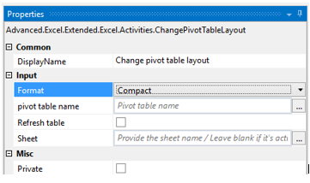
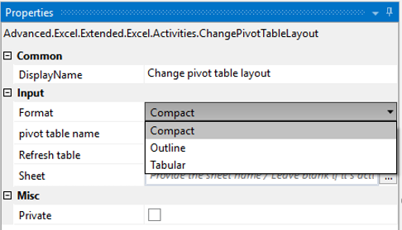
CHANGE PIVOT TABLE LAYOUT
To change the pivot table layout in different format or refresh the pivot table data
Sheet Name : - Provide the Sheet name Pivot Table Name : - Provide the name (Ex. “PivotTable1”) Format : - Dropdown (Compact, Outline, Tabular) Refresh : - Checkbox (Enable it to refresh the pivot)

Slide 23
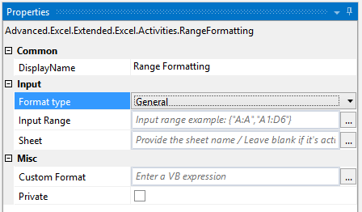
EXCEL SHEET – RANGE FORMATTING
To change the formatting of a column into several formats.
Sheet : - Provide the sheet name Input Range : - For ex. “A:A” Format : - General, text, number, custom. Custom format : - Applicable only if dropdown selected as “Custom” Example : - dd-mmmm-yyyy or #,##0.00_);[Red](#,##0.00)

Slide 24
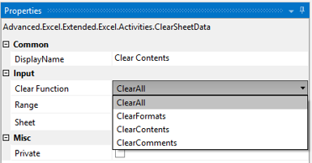
EXCEL SHEET – CLEAR CONTENTS
To Clear the contents, formats, etc.
Sheet : - Provide the Sheet name Range :- Input as (Ex. "A2:M500") Select : - Dropdown list (Clear All, Formats, etc.)

Slide 25
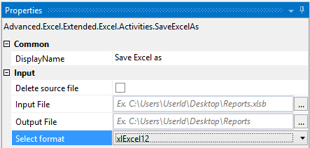
SAVE EXCEL IN DIFFERENT FORMAT
To save excel file in different format. Ex : - .xls to .xlsb
Input File : - Provide the Excel File Name
Output File :- File Name without file extension
Select :- Dropdown (xlExcel12 - .xlsb)
Delete Source File : Checkbox

Slide 26
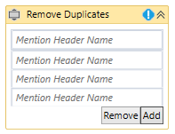
REMOVE DUPLICATES
To remove the duplicates from Datatable or worksheet
Sheet Name : - Provide the Sheet name
Datatable Name : - Provide the Datatable name Header Name : - Provide the Header Name (For ex. “US Employees”) Note : - (Input can be either Datatable / Existing Sheet)

Slide 27
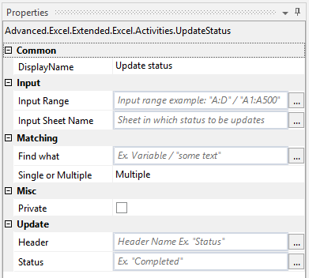
UPDATE STATUS
As you know that we process large number of transaction / invoices so at each stage it’s better to update the status in our tracking worksheet stating so and so invoices is processed so that duplication can be removed or to track the status.
Input Range : - Ex.”A:A” : - Where your search criteria word is available Sheet : - In which sheet you want to search Find what : - What exactly you want to search. (Ex. “India” or row(1).ToString Single or Multiple : - Update the status in immediate found word or in update it in multiple Header : - In which you want to update the status Status : - “Completed” , “Closed”, “Success” or any.

Slide 28
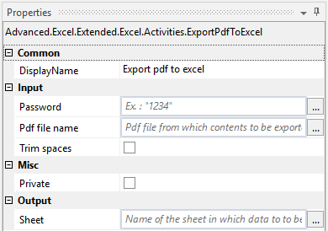
EXPORT PDF TO EXCEL
To export the entire pdf file data to an excel sheet.
Input PDF File : - Provide the pdf file name
Password : - Password if any of pdf file
Trim spaces : - Checkbox – Enable it if you want to trim it
Output sheet : - Provide the worksheet name

Slide 29
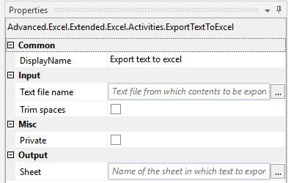
EXPORT NOTEPAD TO EXCEL
To export the entire notepad file data to an excel sheet
Input PDF File : - Provide the notepad file name
Trim spaces : - Checkbox – Enable it if you want to trim it
Output sheet : - Provide the worksheet name

Slide 30
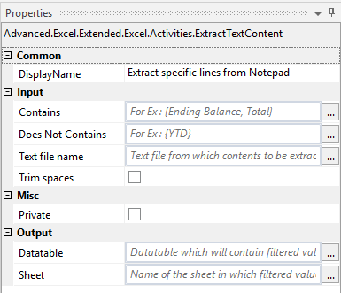
EXTRACT NOTEPAD FILE CONTENT
To extract the required contents from an notepad file
Input Text File : - Provide the Text file name
Trim spaces : - Checkbox Enable : - if you want to trim
Contains : - {“Ending Balance”, “Total”}
Does not contains : - {“YTD”)
Output Sheet : - Provide the worksheet name
Output Datatable: - Provide the Datatable name

Slide 31
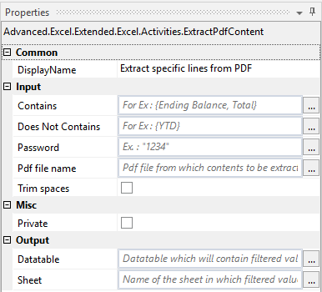
EXTRACT PDF FILE CONTENT
To extract the required contents from an PDF file
Input PDF File : - Provide the pdf file name Password : - Password if any of pdf file Trim spaces : - Checkbox – Enable it if you want to trim Contains : - {“Ending Balance”, “Total”} Does not contains : - {“YTD”) Output Sheet : - Provide the worksheet name Output Datatable: - Provide the Datatable name

Slide 32
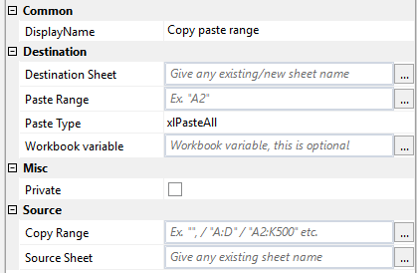
COPY PASTE RANGE
To copy paste the range from one sheet to another or in the same sheet or any other workbook.
Source Sheet : - Provide the Sheet name Copy Range : - For ex. “A:D” / “A2:K500” Destination Sheet : - Provide the Sheet name Paste cell address : - For ex. “A2 Workbook variable : - WB Variable (Excel appln scope - Optional) Paste Type : - Dropdown (xlPasteAll, etc)

Slide 33
THANK YOU
Developed by Rajan Thangavelu

